Slide 1
Geographic & Temporal
Analysis
Online Retail Returns — Checkpoint #2
Q1: Are return rates significantly higher in specific countries?
Q2: Do return volumes vary seasonally across months or quarters?
Sudarsh Mekkampurath Sajeev | Support: Sandra Raj Pattuvakkaran

Slide 2

Project Context, Business Problem, and Objectives
Business Problem Overview
Understand what drives cancellations in online retail by examining patterns across products, customers, geography, and time.
Project Execution Progress
Project has moved from planning into execution with data prepared and initial in geography and time analyses completed.
Objective and Rigor
Demonstrate academic rigor, logical reasoning, and business relevance to support data-driven decision-making.
Notes:
This checkpoint presentation summarizes the progress made in executing the Online Retail Returns project, focusing on geographic and temporal analysis. The business problem centers on understanding why product returns occur and how they impact financial and operational performance. Returns generate direct revenue loss through refunded sales and indirect costs such as handling, logistics, and inventory disruption. The objective at this stage is not to finalize solutions, but to demonstrate that the project has moved decisively from planning into execution, with data prepared, initial analyses completed, and a clear analytical direction established. The analysis aims to identify where returns are concentrated geographically, how they evolve over time, and whether early patterns suggest deeper structural, product-related, or customer-driven causes. This checkpoint also sets the foundation for subsequent customer and product analyses by translating early findings into concrete analytical handoffs. The intent is to show academic rigor, logical reasoning, and business relevance, ensuring that every analytical step can be clearly explained and defended. At this stage, the work demonstrates that return behavior is not random noise but a measurable and structured phenomenon that can be analyzed systematically to support decision-making.

Slide 3
Dataset & Preparation
Online Retail II — Full Two-Year Span
1,048,575
19,261 (1.8%)
43
£1.29M
Transactions
Cancellations
Countries
Cancel Loss
Dec 2009 → Dec 2011 • 2 Full Years
Data Cleaning Steps
Removed zero-price rows (system adjustments, not real sales)
Removed non-product codes: POST, Discount, Manual, D
Combined two cancellation signals: C-prefix invoices + negative quantities
Created unified Is_Return flag for consistent analysis

Slide 4
Q1: Are Return Rates Significantly Higher in Specific Countries?
Answer: YES — two distinct types of risk confirmed statistically
YES
VOLUME RISK
STRUCTURAL RISK
United Kingdom
Germany | EIRE | Japan | Malta
£1,104,222
85.3% of all losses
Cancel rate: 16.4% (moderate)
Risk driven by SCALE, not behaviour
Germany: 27.9% rate (chi²=1249, p=0.000)
EIRE: 22.3% rate (chi²=148, p=0.000)
Japan: 40.0% — ⚠ small sample (55 invoices)
Malta: 40.0% — ⚠ small sample (15 invoices)
Statistical Validation: Chi-square tests confirm rate differences are real, not random (p=0.000 for all high-volume countries). Note: statistical significance does not prove causality — the data SUGGESTS structural issues, but root causes require further investigation.

Slide 5
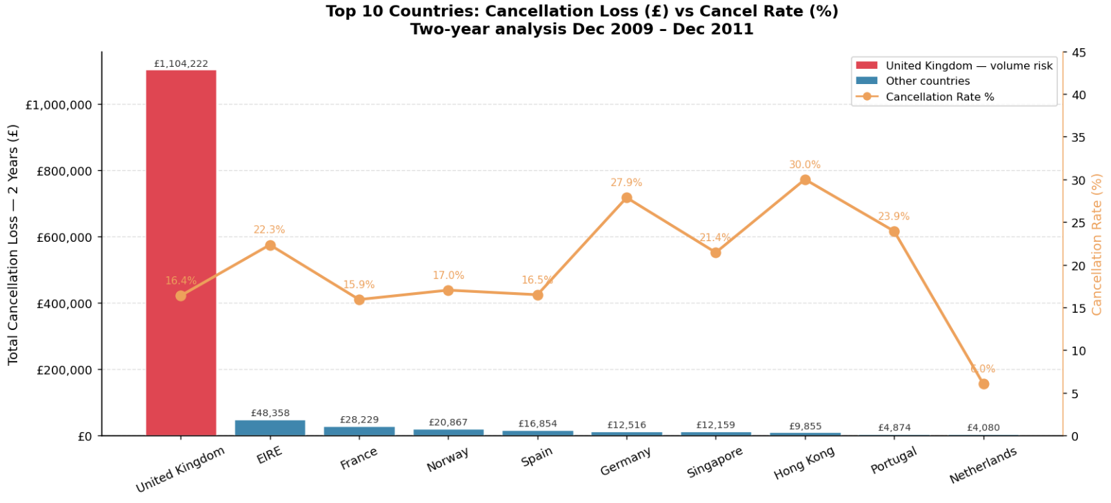

Slide 6
Q2: Do Return Volumes Vary Seasonally Across Months or Quarters?
Answer: YES for volume — NO for behaviour (the critical distinction)
KEY FINDING: Q4 cancel RATE = 16.6% vs Q2/Q3 rate = 16.7% — virtually identical.
Customers are NOT more likely to cancel in Q4. Losses spike because MORE orders are placed — an operations problem, not behaviour.
£259,934
£131,482
−0.167%/month
Q4 2010 Loss
Q4 2011 Loss
Rate Trend
Worst quarter — holiday surge
−49.4% vs Q4 2010 ✓ improving
2010: 17.6% → 2011: 15.7%
Spike Months Identified: Sep 2010 (94,450 units) | Dec 2010 (£134,806) | Jan 2011 (£131,185)
In all three spike months — cancel RATE stayed within normal range (15–19%). Loss spikes = volume driven.
UK Rate Stability: 2010 mean 17.2% (range 15.2–21.1%) | 2011 mean 15.7% (range 12.6–18.8%) → Cancellations are a predictable operational cost, not a volatile crisis.

Slide 7
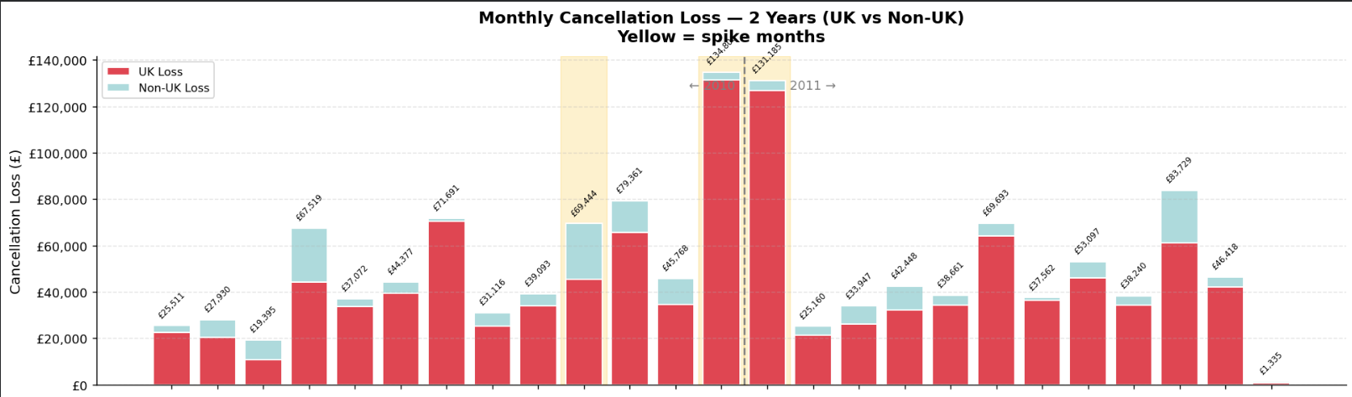
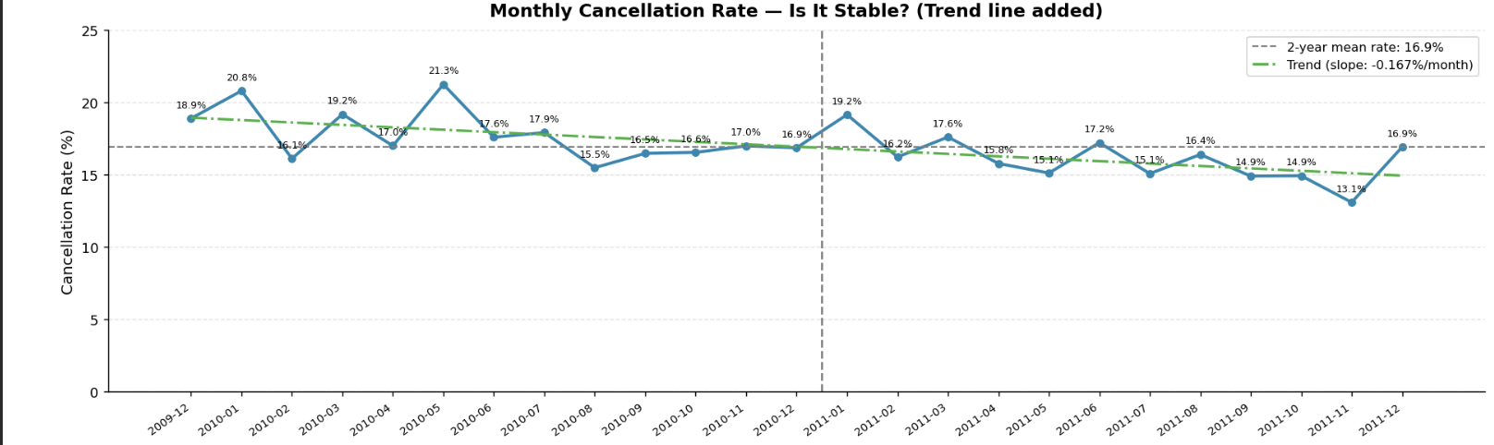

Slide 8
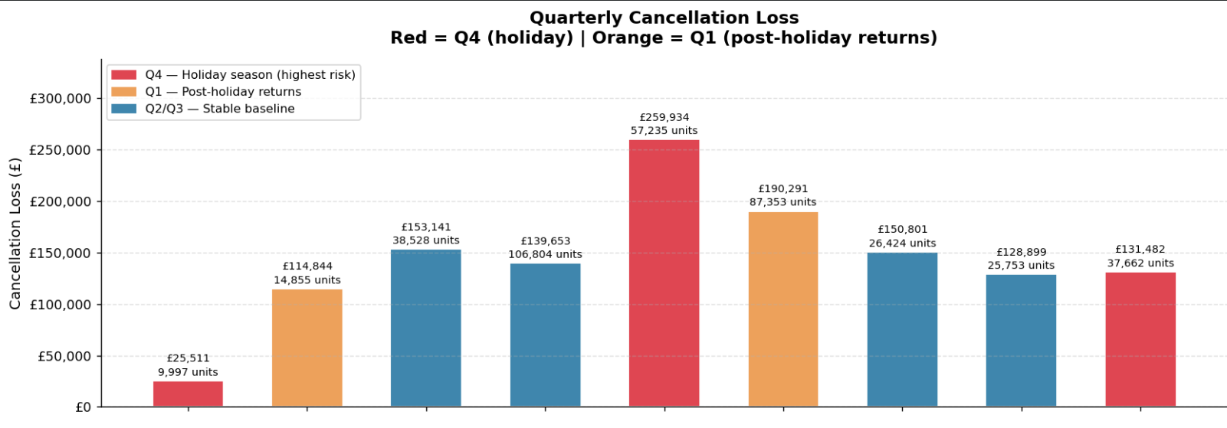
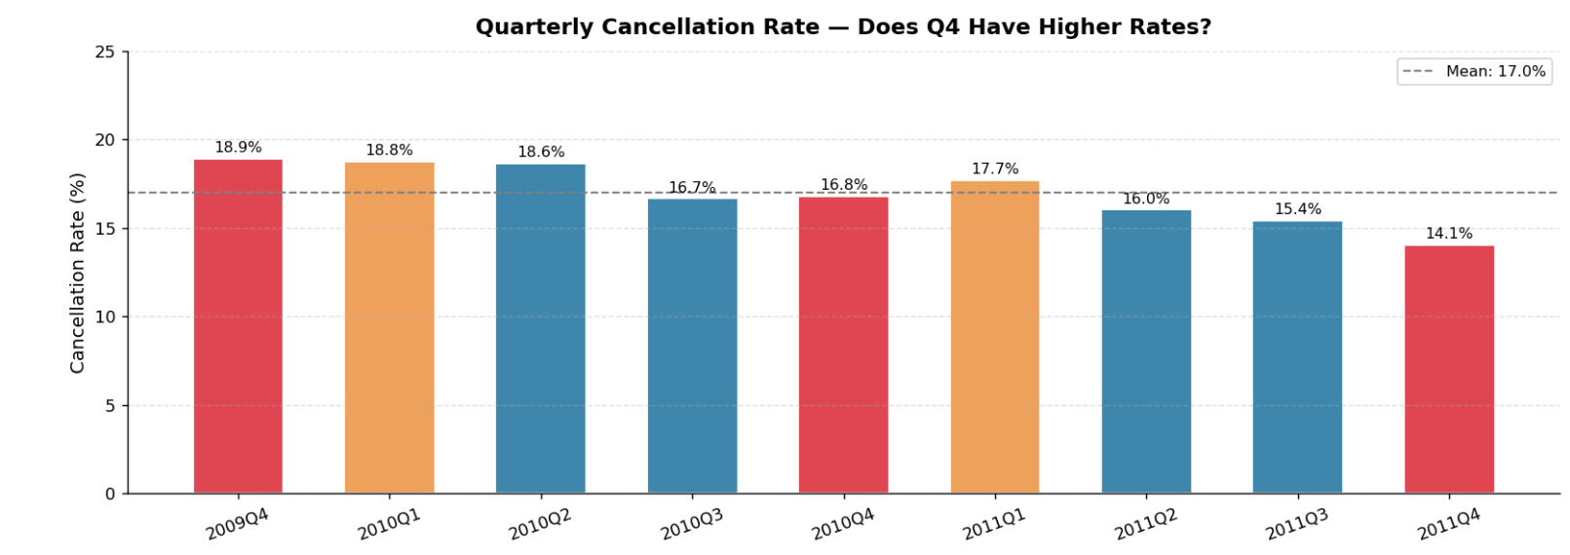

Slide 9
Deeper Finding: What Drives the Spike Months?
MEDIUM CERAMIC TOP STORAGE JAR 74,215 units cancelled | £77,184 loss | spike months: Sep–Dec 2010, Jan 2011
What the pattern suggests:
Important Caveat
74k+ units of ONE product cancelled is not individual customer returns
Pattern is consistent with a bulk B2B order that was placed then cancelled
Spike months are NOT a seasonal customer behaviour shift
Rate stays at 15-19% in spike months — volume, not behaviour
This is consistent with a bulk order — but we cannot confirm from geographic data alone.
Confirmation requires:
• Customer IDs (Renato's section)
• SKU history outside spike months (Okah's section)
Next Explorations →
Okah: Is this SKU problematic year-round or only in spike months? Renato: How many Customer IDs are behind these cancellations?

Slide 10
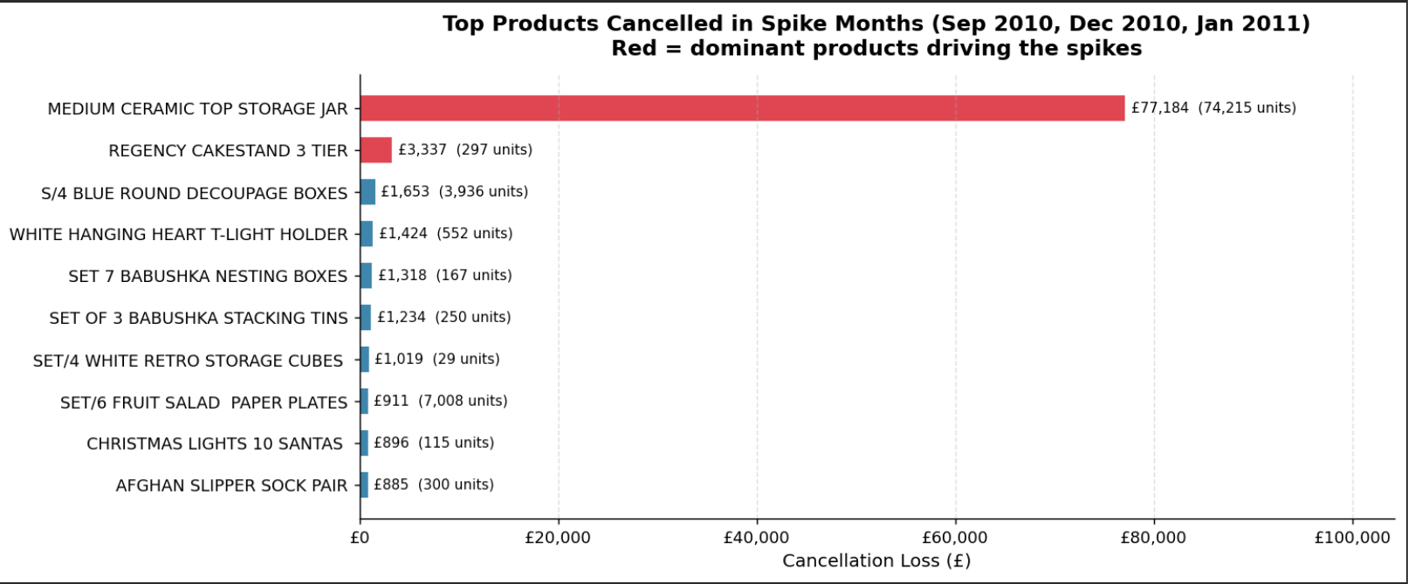

Slide 11
Team Connections & Task Distribution
Analysis focus on the top 6 countries with highest loses.
My Section: Geographic & Temporal
Okah — Product Section
Country summary table + pareto
Chi-square statistical tests (6 countries)
Monthly, quarterly, yearly temporal analysis
YoY comparison — rate improving
UK rate stability 2010 vs 2011
Spike month product identification
Sudarsh + Sandra (support)
Is MEDIUM CERAMIC TOP STORAGE JAR a quality issue or bulk B2B?
Which products are cancelled in EIRE every month?
What caused the Sep 2010 spike (94,450 units)?
Renato — Customer Section
Who are the Customer IDs behind the ceramic jar spike?
Are the same customers cancelling year-round (chronic) or constantly new ones?
Did the high-return customer segment shrink in 2011?

Slide 12
Key Takeaways
01
UK = 85.3% of losses (£1.1M) — scale problem. Fix UK ops = fix most of the problem.
02
EIRE & Germany have structurally elevated rates across both full years — statistically confirmed (p=0.000).
03
Rate is stable year-round at 16–17%. Q4 loss spikes are volume-driven, not behaviour-driven.
04
Rate improving YoY: 17.6% (2010) → 15.7% (2011). Trend = −0.167%/month.
05
Spike months driven by 1–2 SKUs — likely bulk B2B event, not seasonal customer behaviour.
Sudarsh Mekkampurath Sajeev | Support: Sandra Raj Pattuvakkaran | Checkpoint #2

